Slide 1


XLR8 Electrified Session

Slide 2
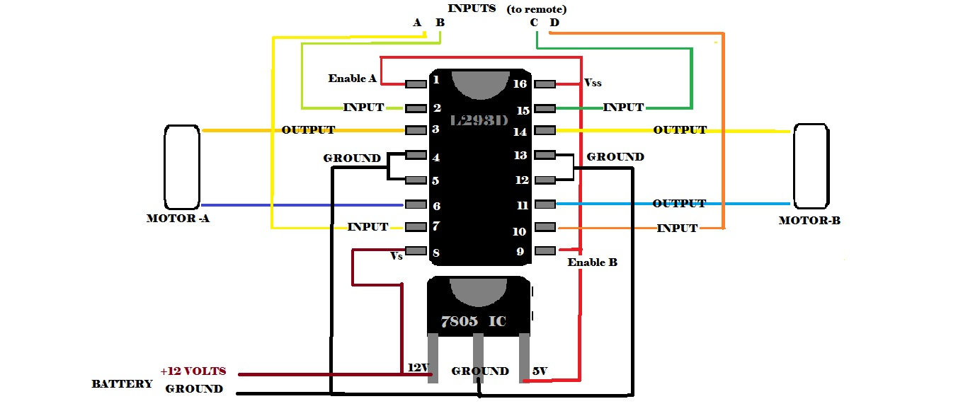
XLR8
Electrical Session

Slide 3
How to control the motors??
4 motors using just 1 remote !!

Slide 4
Let’s start with something
simple and useful….

Slide 5
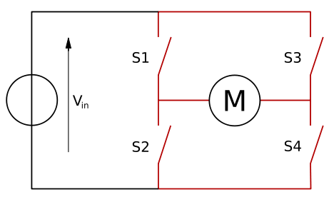
H bridge
An H bridge is an electronic circuit that enables a voltage to be applied across a load in either direction.
See it for yourself in which direction current goes when S1 and S4 are on and when S2 and S3 are on.
Using such a circuit, you can supply current to the motor in two directions!!!!

Slide 6
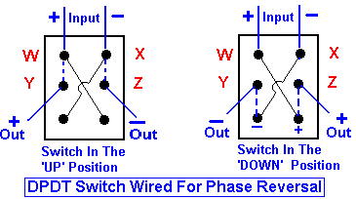
Make your own Remote- DPDT Switches
2 DPDT switches used for 2 Motor each.
Although we will not be using DPDT switches, extra knowledge
doesn’t hurt :P

Slide 7
Our Main task is to build a circuit that will enable us to drive the
motors through switches wirelessly.
For this we would need some Electrical Components
BT RC Circuit: A Circuit to enable the wireless communication
between our Remote and the car
L293D IC: Something to drive the motor as per command
As we would see the above components would work only in some specific voltage range, we would need to build a circuit to convert the DC voltage from a battery to the voltage in specific range

Slide 8
Bluetooth communication Circuit (BT Circuit)
A wireless communication module which we use to control our bot.

Slide 9
How to implement it??
Connect the output pins in BT PCB circuit to corresponding pins of L293D.
Complete connections of the PCB will be taught soon.
Input (through Mobile app)
BT module
Motors
L293D

Slide 10
Now, We need to convert 12V to 5V Any idea how???

Slide 11
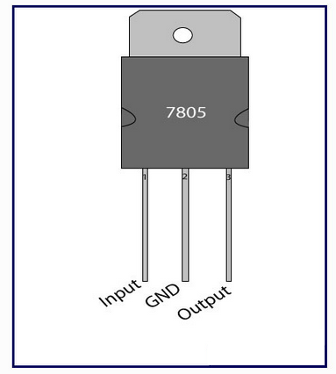

7805 IC
Three terminal positive voltage regulator.
It is used to convert 12V supplied by the battery to 5V.
Don’t forget to attach heat sink as remaining voltage is wasted as heat.
Very important component in a circuit as all RF circuits (to be introduced after few slides) and sensors work on 5 Volts.
1
2
3

Slide 12
As we would see later our car would receive a signal of only of 5 volts or less than 5volts. But our motor needs around > 9V to run and about 12 V to run efficiently. So how do we run motors of 12 Volts???
SOLUTION…????

Slide 13
ANY GUESS??
We need a circuit that acts as a switch
i.e. when it gets 5volt signal it switches 12 volts to the motors.

Slide 14
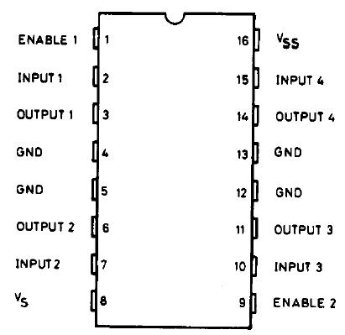
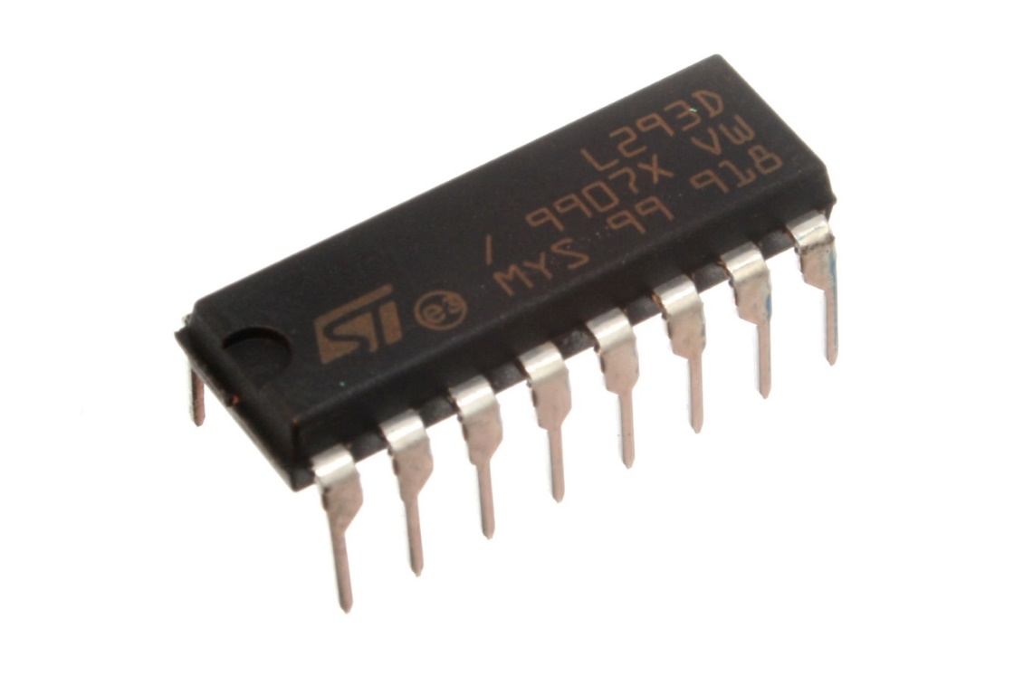
L293D – Motor Driver IC

Slide 15
So, here we are…… to the brain again

Slide 16
B

Slide 17
When a input is given the information is encoded and converted into a signal.
The signal is then transmitted through Bluetooth communication.
At the Receiver the information received is given to the L293D IC.
L293D IC drives the motors by giving them 12v output.

Slide 18
Any Doubts ???
We have our answers now. ☺

Slide 19
Thanks! And Keep XLR8ing!!
Sudeep: 9987894735
Avineil: 09824469955
Parth : 9167633979
Deepak : 9967687636
Atish : 9987700750

